Slide 1
1.我相信你会认真对待我的投诉,我的需求将被满足。
2.我对我的行为造成的问题深表歉意，希望我能努力弥补。
3.任何语言都无法表达我的真挚谢意。我们想邀请你在不久的将来访问中国。(感谢+回报)
4.信的后面是一个吉祥的中国，愿你人生新台阶上的每一刻都充满喜悦!（回赠+祝愿）
5.再次感谢你的慷慨的帮助,祝你所有最好的。(感谢+祝愿)
6.非常期待你的出现
7. 祝您返程愉快,未来一切都好。(欢送+祝愿)
8. 我们热切希望有一天你能访问中国，让我们有机会来报答你的好意。

Slide 2

2. 合理拓展，语义连贯，彰显思维品质
交际性拓展：借助语言支架，进行产出性思维表达， 写信结束语（角色代入，第三段1-2行）
写作者+写作体裁框架下的期盼、祝愿、鼓励等情感+写作对象
I believe you will take my complaint seriously and my demand will be met.（投诉+维权）
I deeply apologize for the problems my actions have caused, and I hope I can work to make up for it.（道歉+愿望）
1. My true gratitude is beyond any words. we'd like to invite you to visit China sometime in the near future.（感谢+回报）
2. Attached to the letter is an auspicious Chinese knot. May every moment full of joy on your new stage of life! （回赠+祝愿）
3.Thanks again for your generous help and wish you all the best.（感谢+祝愿）

Slide 3
2. 合理拓展，语义连贯，彰显思维品质
交际性拓展：借助语言支架，进行产出性思维表达， 写信结束语（角色代入，第三段1-2行）
写作者+写作体裁框架下的期盼、祝愿、鼓励等情感+写作对象
1.Please come on time. I am sure you will have a wonderful time there/then. （通知+祝愿）
2.Your presence is highly expected.（告知+邀请）
1. Wish you a pleasant journey home and all the best for the future.（欢送+祝愿）
2. We are keen that someday you will visit China when a cherished chance can be provided to repay your kindness.Thanks!（欢送+期盼）

Slide 4
道歉信
（202103名校协作体联考）假定你是李华，应美国朋友George请求，帮他购买了学习汉语的教科书，但是忘记及时寄出。请根据以下要点用英语给他写一封电子邮件：
1.表示歉意；2.解释原因；3.弥补措施。

Slide 5
道歉信
（202103名校协作体联考）假定你是李华，应美国朋友George请求，帮他购买了学习汉语的教科书，但是忘记及时寄出。请根据以下要点用英语给他写一封电子邮件：
1.表示歉意；2.解释原因；3.弥补措施。
Dear George,
I’m terribly sorry to tell you I’ve forgotten to send you the Chinese textbook you asked to buy this Friday as promised.
I’ve been super busy preparing for the final exams the whole week. My mind was so preoccupied with all the mathematical formulas_{/ˈ}and English grammar items that it totally slipped my mind. Plus, my grandpa suddenly fell ill last week and I had to attend him after class.
You have my word that I’ll go to the post office tomorrow morning.
Yours faithfully,
Li Hua

Slide 6
道歉信
（202103名校协作体联考）假定你是李华，应美国朋友George请求，帮他购买了学习汉语的教科书，但是忘记及时寄出。请根据以下要点用英语给他写一封电子邮件：
1.表示歉意；2.解释原因；3.弥补措施。
Dear George, (修）
I’m terribly sorry to tell you I’ve forgotten to send you the Chinese textbook you asked to buy this Friday as promised.
I’ve been super busy preparing for the final exams the whole week. My mind was so preoccupied with all the mathematical formulas and English grammar items that it totally slipped my mind. Plus, my grandpa suddenly fell ill last week and I had to attend him after class. Please forgive me for my fault. You have my word that the book will be expressed tomorrow morning and it is due to arrive a week later.
Sorry again for the inconvenience I brought to you.
Yours faithfully,
Li Hua

Slide 7
道歉信
（202103名校协作体联考）假定你是李华，应美国朋友George请求，帮他购买了学习汉语的教科书，但是忘记及时寄出。请根据以下要点用英语给他写一封电子邮件：
1.表示歉意；2.解释原因；3.弥补措施。
P1表示歉意（背景信息，因果拓展）
I'm writing to convey my deepest apology for my not timely posting the Chinese textbook you asked me to buy for you.
我写信是为了表达最深的歉意，没有及时把汉语的教科书邮发给你。
P2解释原因（陈述错误，尊重事实）
Bumping up against (遇到...困难encounter）a crucial exam, I've had a tight schedule last week to prepare for it. Somehow, I was too busy to entirely forget about your book, which is expressed until right now, and it's due to arrive a week later.
碰上了一个重要的考试，我上星期把日程安排得满满的。不知怎么的，我太忙而完全忘记你的书，直到现在才被寄出，应在一周后到。

Slide 8
道歉信
（202103名校协作体联考）假定你是李华，应美国朋友George请求，帮他购买了学习汉语的教科书，但是忘记及时寄出。请根据以下要点用英语给他写一封电子邮件：
1.表示歉意；2.解释原因；3.弥补措施。
P3弥补措施（敢于担当，付诸行动）
In order to make up my stupid mistake, I decide to send it to you right now. Meanwhile, I hope the attached Chinese knot can convey my sincere apology.
为了弥补我愚蠢的错误，我决定现在就把它发给你。同时，我希望附上的中国结能传达我真诚的歉意。
Please forgive me for my fault. I also send you a delicate chinese tea cup to make up for any inconvenience caused.
请原谅我的过错。我还送你一个精致的瓷器茶杯，以弥补给你带来的不便。

Slide 9
祝贺+建议
（202104金华十校）假定你是李华，你的好友Steven即将代表学校参加全市留学生中文演讲比赛，写信向你求助。请你给他回一封信，内容包括：
1.表示祝贺；2.提供建议；3.表达祝愿。
Dear Steven,
Overjoyed to hear that you will represent our school to be engaged in the city's Chinese speech contest for overseas students. Congratulations! And I am here willing to offer some relevant suggestions.
First, you can seek Chinese teachers' professional guidance to reinforce your language proficiency and accuracy. Second, watch videos of previous speech contests, which will help better your speech skills, like the application of gestures. Additionally, staying self-assured is what it takes to guarantee your performance and bring out the best in you.
I genuinely hope that your unremitting(painstaking) effort will pay off ultimately.
Yours,
Li Hua

Slide 10
竞选演讲稿——文化交谊小使者(Young Ambassador for Cultural Exchange)
（202104 广州二模）为迎接国外姐妹学校来访师生，学校准备选拔"文化交谊小使者(Young Ambassador for Cultural Exchange)"，你打算参加。请写一份英语竞选演讲稿。内容包括:1.自我介绍; 2.竞选理由.
Good morning,dear judges. 1'm Candidate No1. It’s my great privilege to deliver a speech here to compete for the Young Ambassador for Cultural Exchange.
First of all, please allow me to make a brief self-introduction. I am Li hua, the president of the students’ union. ①My confidence comes from my fluent oral English, my rich relevant experience and my enthusiasm and passion for cultural exchange. I’ve been in several international summer camps, from which I’ve acquired the knowledge and skills of communicating with foreign students. Voluntary work in the city museum last summer also deepened my understanding of our city and enabled me to communicate with people much more freely. ②I’m eager and ready to spread the essence of Chinese culture to our foreign guests and serve as a bridge between our two schools.
Hopefully, I will be offered the golden chance to contribute as a cultural exchange ambassador .Thank you for your attention!

Slide 11
约稿函
（202103台州二模）假定你是校英文报 Teens Today的学生主编，本学期该报拟开设专栏"科技与人文"（Technology and Humanity），向全校同学征集稿件。请你写一封征稿函，内容包括∶1. 稿件要求; 2. 投稿方式; 3.录用奖励。
Dear fellows,
We are proud to announce that Teens Today will be starting a new column featuring "Technology and Humanity"this term! And we are expecting your theme-related articles.
The contributions should cover your authentic experiences with technology and unique insight into how technology is reshaping your lives. They are required to be original and within 300 words. Please submit your articles before 18th each month to editor @leens Today. org. Any contributor whose works appear in our column will be awarded a certificate of acceptance and 50 Yuan in prize money.
Looking forward to your works!
Teens Today

Slide 12
英文报道— 环保（交换闲置物品）
（202104 深圳市高三年级第二次调研考试）4月22日，你校举行了 Earth Day Trade活动，议同学们交换闲置物品。请你为学校英文报写一篇报道，内容包括:
1.时间、地点 2.活动简况 3.活动效果。
An activity named Earth Day Trade was held at 5 P. M. on April 22 in our school to raise the students’ awareness of caring for the earth.
The students actively took part in it and brought the stuff that they didn’t need any more to the school. Many old things were traded, such as books, used electronic devices and so on. The students were glad that their old stuff wouldn’t end up in trash cans, but instead turned out useful to others.
The activity proved a big success, and the students involved realized that even small acts could make a difference to the earth.

Slide 13
第一节：应用文写作（满分15分）金丽衢12校5月
假如你是李华，你校将在校内给老师安排自愿接种新冠疫苗活动，请写信通知你的外教David，内容包括：
1. 时间和地点；
2. 注意事项；
3. 建议参加。
参考词汇：疫苗：vaccine 接种疫苗：get vaccinated

Slide 14
Dear David,
I’m LI Hua, writing to inform you of the COVID-19 vaccination arrangement of our school.
According to announcement released by school commission, there will be a COVID-19 vaccination lasting/scheduled from 1st to 5th of May at school’s clinic, from whose website you can browse relevant information. Once you’ve made up your mind to get vaccinated, these following tips should be borne/kept in your mind: check up if you’re allergic to the vaccine; stay at site for 30 minutes after getting the shot and alcohol should be excluded from your diet since then.
I strongly suggest you seek vaccination, which not only protects you, but those around you.
Yours,
Li Hua

Slide 15

要点关联，重点拓展
让语言插上腾飞的翅膀
词汇妥帖，语法无误，
高分作文必作于细成于严

Slide 16
3. 词汇妥帖，语法无误，格式正确，高分作文必作于细成于严
（2019年06月浙江高考应用文写作）假定你是李华，经常帮助你学习英语的朋友Alex即将返回自己的国家。请给他写一封邮件，内容包括：
1. 表示感谢；2. 回顾Alex对你的帮助；3. 临别祝愿。
I’m Li Hua, I’m writting to express my sincerely thank for you.
2. Having known that you will come back to your own country. I’m writing to extend my appreciations and thanks.
I’m writing to express my sincere thanks for your assistance.
to you
拼写错误
词性错误
复数错误
搭配错误
Having known that you will go back to your own country, I’m writing to extend my appreciations and thanks.
动词错误
悬垂修饰语 误用

Slide 17
3. 词汇妥帖，语法无误，格式正确，高分作文必作于细成于严
（2019年06月浙江高考应用文写作）假定你是李华，经常帮助你学习英语的朋友Alex即将返回自己的国家。请给他写一封邮件，内容包括：
1. 表示感谢；2. 回顾Alex对你的帮助；3. 临别祝愿。
3. Learning that you’ll back your country, so I’m writing to express my best wish for you.
4. Mixed with sad and grateful, I’m writing this letter to convey my best wishes and sincerely gratitude.
悬垂修饰语 错误
Learning that you’ll go back to / return to your country, I’m writing to express my best wishes for you.
名词复数错误
动词、介词错误
Mixed with sadness and gratefulness, I’m writing to convey my best wishes and sincere gratitude.
词性错误
惯用法错误

Slide 18
3. 词汇妥帖，语法无误，格式正确，高分作文必作于细成于严
（2019年06月浙江高考应用文写作）假定你是李华，经常帮助你学习英语的朋友Alex即将返回自己的国家。请给他写一封邮件，内容包括：
1. 表示感谢；2. 回顾Alex对你的帮助；3. 临别祝愿。
5. Under your help, my written English had an enormous progress.
6. It is you who patiently solved my endless English problem.
With your help, my written English made great /significant/ tremendous progress.
名词错误
（不可数名词）
词组错误
词组错误
It was you who patiently solved my endless English problems.
时态错误
名词复数错误

Slide 19
3. 词汇妥帖，语法无误，格式正确，高分作文必作于细成于严
（2019年06月浙江高考应用文写作）假定你是李华，经常帮助你学习英语的朋友Alex即将返回自己的国家。请给他写一封邮件，内容包括：
1. 表示感谢；2. 回顾Alex对你的帮助；3. 临别祝愿。
7. Looking back to the past few months, you’ve helped me explore, accumulate and progress steadily in my English study.
8. Not only did you teach me grammar, but you also did me a favor to spell words well, thus contributing to my better reading skills .
Looking back to the past few months, I vividly/well remember that you helped me explore, accumulate and progress steadily in my English study.
悬垂修饰语 误用
时态错误
writing skills
逻辑错误

Slide 20

3. 词汇妥帖，语法无误，格式正确，高分作文必作于细成于严
01
02
通过对以上22个写作中真实的错误案例的分析和不完全统计，动词搭配和使用不当占25%，名词单复数错误占18%，词性混乱18%，句子意识薄弱（主要是悬垂修饰语或标点符号的误用）占14%，时态错误占9%。
为了具备较强的语言运用能力，达成有效交际，我们要夯实基础，语言准确，写作时注意人称、数、时态等英语思维，避免汉式英语；能够准确使用大纲重点词汇和短语，做到表意清楚，语法无误，句型正确，地道自然。

Slide 21
3. 词汇妥帖，语法无误，格式正确，高分作文必作于细成于严
开头称呼语
信件邮件：
熟悉的朋友 (Dear + first/given name名) 但要注意的是，“Mr./Ms. + 名字”是不规范的写法，不应该使用Mr. Jason 或 Ms. Sara
Dear James / Sara,
第一次发邮件联系对方（最为妥当的方式使用“Dear Mr. / Ms.加对方的姓氏 （family/last name ）不知道已婚或者未婚的女士， 一律用Ms.更为稳妥）
Dear Mr Bennet / Ms White / Miss Ellis,
不知道对方的姓名（但知道对方的头衔/身份，使用“Dear+ Title ”来称呼对方，显得非常礼貌）
Dear Teacher / Editor / Headmaster / Manager,
至相关人员 /敬启者/致有关人士(无法确定对方的身份和具体称呼时才使用)
Dear Sir or Madam,
To whom it may concern，

Slide 22
3. 词汇妥帖，语法无误，格式正确，高分作文必作于细成于严
开头称呼语
致词 （欢迎/ 欢送/ 会议）
Good evening, dear teachers and fellow students!
Dear American friends, / Dear fellow students, / Ladies and gentlemen
招聘信 /征稿启事 Volunteer Wanted/Contributions wanted
书面通知 Notice
口头通知
Hello, everybody/everyone.
Ladies and gentlemen. May I have your attention, please? I have an announcement to make.
海报
English Corner, Learners’ Garden

Slide 23
3. 词汇妥帖，语法无误，格式正确，高分作文必作于细成于严
落款 结束
书面通知
The Students’ Union
October 10, 2020
口头通知 / 致词（欢迎/ 欢送/ 会议）
Thank you(for your attention/listening)
信件邮件：
Yours respectfully, 此致敬礼
Li Hua 写给长辈上级
Yours cordially/ faithfully/ genuinely, 真诚的/热忱的/忠诚的
Li Hua 写给商务/ 平辈朋友

Slide 24
3. 词汇妥帖，语法无误，格式正确，高分作文必作于细成于严
时间地点的表达
1. 表达“上午/下午”，可在时间后加上a.m./ p.m.
eg：we’ll get together at the school gate at 7:30 am. June 21st, 2019
2. 时间地点均由小到大：at half past eight on June 21st, 1996
3. 月份+序数词
eg：2001年4月2日→ April 2nd, 2011.（序数词熟记规律：1 2 3
st nd rd 。8后少t ，9少e即eighth，ninth，整十数把y变ie twentieth）
eg：during the dates of 1st to 10th May
4. “在…”， last/next/this Wednesday/week 前不加介词in/on.
every minute/each time作状语，不加介词at
5.一般来说,地点在前,时间在后。如：人物-地点-时 间
eg： 她上周五和她妈妈在花园里浇花
She watered the flowers with her mother in the garden last Friday.

Slide 25
时间地点的表达
假定你是李华，你校将举办外国学生中文演讲比赛，请给你的英国朋友George 写封邮件邀请他参加。内容包括：1.比赛时间（2020年1月浙江高考试题应用文——邀请告知信）
①比赛定于6月13日下午6点在学校礼堂举行，持续两个小时。
②根据之前的安排，为外国学生量身定做的比赛将于下周周五上午9点至11点举行，主题为中国美食文化。
①The contest is scheduled to take place in school auditorium, at 6:00 p.m. on June 13th and will last for two hours.
②According to the prior arrangement, the competition tailored for foreign students will be launched from 9:00 a.m to 11:00 a.m. next Friday with the theme of Chinese cuisine culture. prior /ˈpraɪər/ adj. （时间、顺序等）先前的 cuisine /kwɪˈziːn/ 烹饪；风味
遵循了“先地点后时间，由小到大”的英语时间地点表达习惯，且告知活动的时长“last for two hours, from 9:00 a.m to 11:00 a.m.”，体现了作者考虑周到，有利于对方酌情考虑。动词“scheduled, arrangement” “take place, launched”表意清楚，语法无误，句型正确。

Slide 26
3. 词汇妥帖，语法无误，格式正确，高分作文必作于细成于严
常用时间的表达
星期的拼写：
月份的拼写：
1. 星期一
2.星期二
3.星期三
4.星期四
5.星期五
6.星期六
7.星期日
1.Monday
2.Tuesday
3.Wednesday
4.Thursday
5.Friday
6.Saturday
7.Sunday
1. January 2. February
3. March 4. April
5. May 6. June
7. July 8. August
9.September 10.October
11.November 12. December

Slide 27
3. 词汇妥帖，语法无误，格式正确，高分作文必作于细成于严
常见地点的表达
学校：
礼堂 auditorium /ˌɔːdɪˈtɔːriəm/ ; lecture hall
体育馆 stadium /ˈsteɪdiəm/ ; gymnasium /dʒɪmˈneɪziəm/
国际交流中心 the International Exchange Center
科技馆 the Science Museum
教学楼3楼301室 Room 301 in the Teaching Building
社会：
敬老院 the nursing home
画廊 gallery /ˈɡæləri/
博物馆 museum
学校：
礼堂 auditorium /ˌɔːdɪˈtɔːriəm/ ; lecture hall
体育馆 stadium /ˈsteɪdiəm/ ; gymnasium /dʒɪmˈneɪziəm/
国际交流中心 the International Exchange Center
科技馆 the Science Museum
教学楼3楼301室 Room 301 in the Teaching Building
社会：
敬老院 the nursing home
画廊 gallery /ˈɡæləri/
博物馆 museum

Slide 28
3. 词汇妥帖，语法无误，格式正确，高分作文必作于细成于严
报名方式
假定你是李华，你校将举办外国学生中文演讲比赛，请给你的英国朋友George 写封邮件邀请他参加。内容包括：3.报名方式（2020年1月浙江高考试题应用文）
① Besides, don't forget to send your personal information to our school website to get a qualification.
② As a language enthusiast, you can sign up for_{报名参加}/ enroll for_{登记参加}/ enter for_{报名参加（比赛）} the contest on our school website, and I'm sure that your sparkling thoughts will definitely be appreciated.
③ It's a fantastic opportunity to express your love for life and gain an insight into different cultures. You can't afford to miss it. If interested, please contact me early and register for you.
④ If the competition ignite your interest, don't hesitate to submit your application through the e-mail.
⑤ Given your superb eloquence口才 and immense enthusiasm in Chinese, I'm wondering if the contest holds a fascination for you, in which case you are supposed to submit your application on our school website before Wednesday.
用“website，e-mail，contact me”方式,“sign up for/ enroll for/ enter for /register”或“send your personal information, submit your application”表达到位，使用精准，妥贴清晰，容易理解，达成有效交际。其中②③④⑤使用因果逻辑拓展报名目的（因），告知报名方式（果），易于打动对方。写作时我们要将自己置身于沟通语境中，拿捏得体语气，真正了解和尊重对方。

Slide 29
3. 词汇妥帖，语法无误，格式正确，高分作文必作于细成于严
联系方式
假定你是李华，乘坐FL753航班抵达伦敦后发现钱包遗失。请给航空公司写一封邮件说明情况并寻求帮助。内容包括：3.联系方式。（2018年11月浙江高考应用文）
① Whenever you get my wallet, please contact me at 1234567.
你们无论什么时候找到我的钱包，请打1234567与我联系。
② Please call 8888-6666 if you gain any information about it.
如有任何关于钱包的信息，请致电8888-6666。
③ If found, please contact me at 153767676 at your earliest convenience.
如果找到，请尽快打电话153767676与我联系。
“联系方式”要求具体详实，有些学生只提到联系“Please contact me at any time”但没有具体方式，不能体现实际交际功能。
我们要关注身边事、留心观察生活、多了解生活常识，积累写作素材；在写作时，尽管人物都是李华，但李华每次的处境和任务不一样，我们要设身处地把自己变成作品中的人物，去体味、去揣摩、去进入角色，才能使文章生动感人，真实可信，从而达成共鸣和有效交际。

Slide 30
3. 词汇妥帖，语法无误，格式正确，高分作文必作于细成于严
活动反响
假定你是李华, 上周日你校举办了5公里越野赛跑活动。请你为校英文报写一篇报道, 内容包括:1. 参加人员；2. 跑步路线:从校门口到南山脚下；3. 活动反响。（2020年7月新高考全国卷Ⅰ--山东卷 应用文）
① The magnificent scenes along the route erased our anxiety/ agitation _{/ˌædʒɪˈteɪʃn/ 焦虑不安；忧虑；烦乱} for the approaching College Entrance Examination and brought us enormous delight/gaiety _{/ˈɡeɪəti/快乐} .
沿途的壮丽景色抹去了我们对即将到来的高考的焦虑不安，给我们带来了巨大的快乐。
② We exposed and explored ourselves to splendid nature, which erased our tiredness/ fatigue _{/fəˈtiːɡ/ n. 疲劳，疲乏} and pressure caused by heavy study.
我们将置身于在美丽的大自然中，这消除了我们繁重的学习带来的疲劳和压力。
③ The race was of great benefit to the participants, physically and mentally. Therefore, we all think highly of it, and expect more activities like this in the future.
赛跑对参赛者的身体和精神都有很大好处。因此，我们都盛赞并期待在未来有更多这样的活动。

Slide 31
3. 词汇妥帖，语法无误，格式正确，高分作文必作于细成于严
④Challenging as the activity was让步倒装, everyone enjoyed it and all the participants benefited a lot from it.（总）
虽然活动很有挑战性，但每个人都很享受，所有参与者都从中受益。
⑤ Aimed to fight against pollution while enjoying the great outdoors,the Cross-Country Eco-Race Carry is designed to pick up food packaging and other such trash while running, and contribute to environmental protection along the route! （细）
旨在与污染作斗争的同时，享受美好的户外，越野生态背包跑 捡起食品包装等垃圾，并为沿途的环境保护做贡献!
⑥ This activity emphasized students’ overall development, especially in physical health and mental endurance . It also boosted morale _{/məˈrɑːl/ n. 斗志} of the teaching staff, awaking them to the importance of regular workout. （细）
这项活动强调学生的全面发展，特别是在身体健康和心理耐力方面。它还提高了教师的士气，使他们意识到定期锻炼的重要性。

Slide 32
3. 词汇妥帖，语法无误，格式正确，高分作文必作于细成于严
活动反响
假定你是李华, 上周日你校举办了5公里越野赛跑活动。请你为校英文报写一篇报道, 内容包括:1. 参加人员；2. 跑步路线:从校门口到南山脚下；3. 活动反响。（2020年7月新高考全国卷Ⅰ--山东卷 应用文）
⑦ By immersing everyone in the charm of nature, this activity definitely offers relaxation to us. Not only can it strengthen our perseverance, but it enhances our friendship.
让每个人都沉浸在大自然的魅力中，这个活动无疑给我们带来了放松。它不仅能加强我们的毅力，也能增进我们的友谊。
⑧ After the event, we felt that not only did the event improve our physical and psychological quality, but it also helped us build a positive attitude towards life. We do hope that the school will carry out more similar activities in the future.
活动结束后，我们感到这次活动不仅提高了我们的身体和心理素质，还帮助我们树立了积极的生活态度。我们希望学校今后能开展更多类似的活动。

Slide 33
跨文化沟通能力，
传播中华文化的能力
让考试插上腾飞的翅膀
高考方向和预测

Slide 34
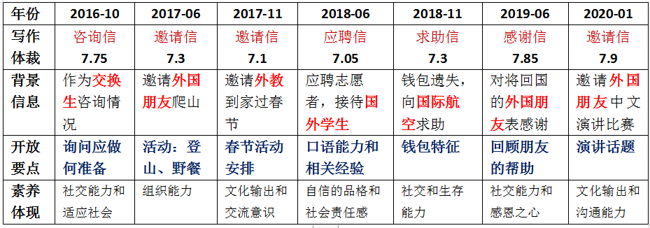
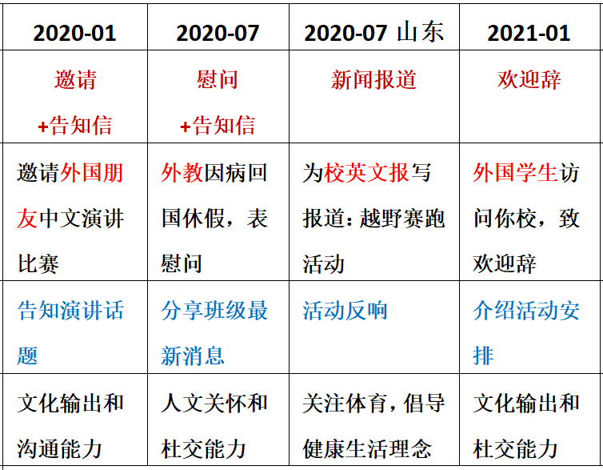
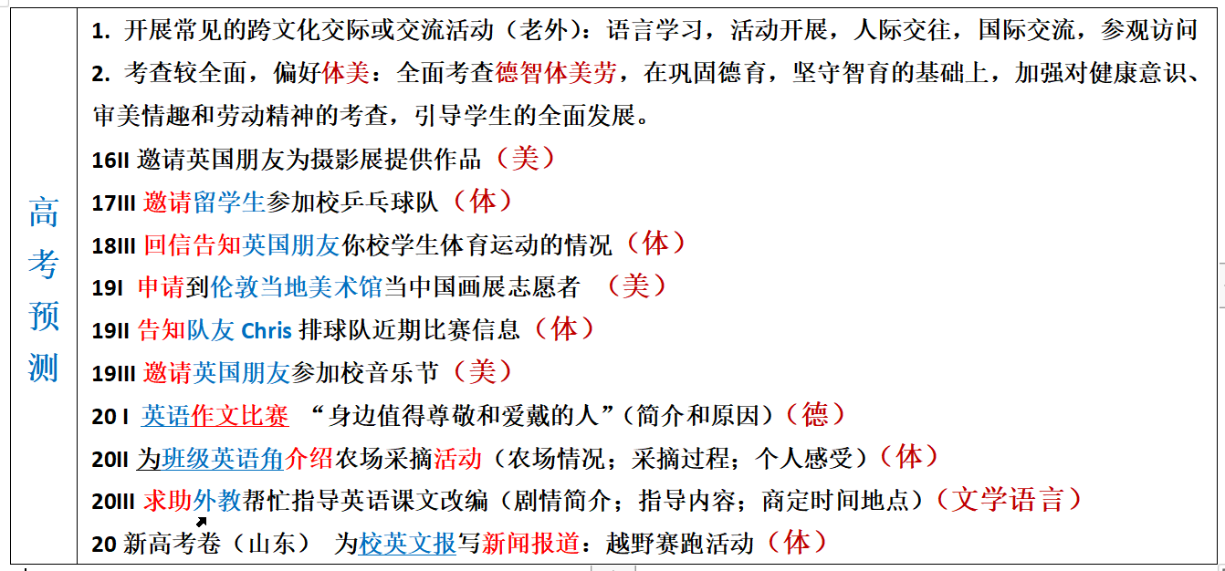
4. 高考方向和预测 —— 偏好体美，全面考查德智体美劳
体
体

Slide 35
德智体美劳; 招聘志愿者; 通知告示；国际视野家国情怀
（2021届江苏省如皋市高三上学期第三次月考英语试题） 如皋国际马拉松赛将于2021年3月举办，请你代表如皋马拉松协会写一封80字的告示，招募志愿者。告示需包括:
1.申请者所应具备的基本素养; 2.你认为的有关信息。
Notice
_______________________________________________________________
Rugao Marathon Association
Notice
Volunteers are needed for Rugao Marathon to be held in March 2021. Basic requirements are familiarity with race course and proficiency in English. Other requirements include good interpersonal communication abilities, familiarity with our city’s tourist attractions and its history, proper manners, and a strong sense of responsibility. Preference will be given to those experienced in similar activities.
Call87654321 or email www.rugao marathon.com for application and for information on the interview. Phone and email enquiries are encouraged; no visits please.
Rugao Marathon Association

Slide 36
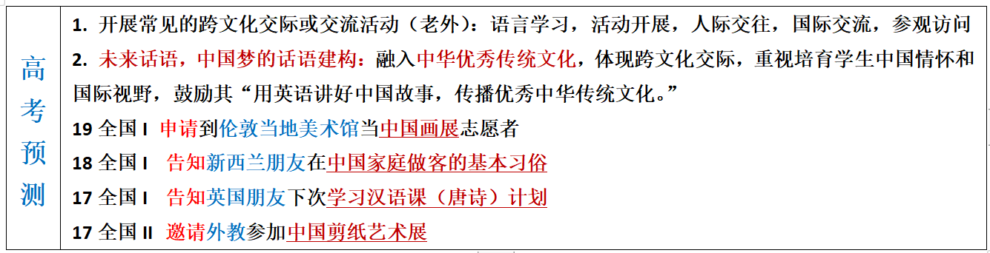
4. 高考方向和预测 —— 未来话语，中国梦的话语建构
文体活动
文化活动
文化活动
文化活动
回避政治敏感话题；
促进中外文化交流
时事要事中国梦

Slide 37
文化学习；国际视野；文化输出
假定你是李华，经常帮助你学习英语的朋友Alex即将返回自己的国家。请给他写一封邮件，内容包括：1. 表示感谢；2. 回顾Alex对你的帮助；3. 临别祝愿。（2019年6月浙江高考——感谢信）
Dear Alex,
Hearing your departure, I’m writing to express my sincere gratitude for your generous help.
Last year has witnessed my harvest in English. When I was messed up with all the language obstacles, It was your patience and guidance that enlightened me. Besides you always offered to revise the language style of my writing practice, which enabled me to savor a dip of authentic English. With cross-cultural notions and visions being exchanging, my knowledge scope was enriched and our friendship has been flourishing!
Attached to the letter is an auspicious Chinese knot. May every moment full of joy on your new stage of life!
Yours genuinely,
Li Hu
be messed up with（糟糕面对）； enlighten（启发；教导）；
savor a dip of（品尝，欣赏）； authentic（真正的，真实的）；
notion and vision（概念与视野）； scope （ /skəʊp/ 视野；眼界）；
flourish (/ˈflʌrɪʃ/ v.茂盛；茁壮成长) ; auspicious（ /ɔːˈspɪʃəs/ 吉祥的）

Slide 38
文化交流；国际视野；文化输出
（2021年1月浙江高考——致欢迎辞）
假如你是李华，下周新西兰学生访问你校，你将作为学生代表致欢迎辞。请为此写一篇发言稿，内容包括：1.表示欢迎；2.介绍活动安排；3.表达祝愿。
During your visit, we will do a lot of interesting things together, including watching kungfu, visiting a tea museum, learning ink painting, and trying different kinds of Chinese food. We will also take you to an ancient town, where you will learn about the local culture. Finally, we really look forward to interacting with you and wish you a good time here! 范文
After the welcome meeting, we will show you around the school so that you can be more familiar with it. Then you will attend a Chinese class where you can savour a dip of the beauty of Chinese. At noon, you can enjoy some traditional Chinese delicacies. The following hours you will experience paper cutting, exploring the magic of Chinese art.

Slide 39
文化交流；建议信件；文化输出
（2018年 10月稽阳联考）假定你是李华，你的英国朋友Peter来信就下周三要参加孔子学院(the Confucius Institute)的面试征询你的意见。请你写封回信，内容包括： 1. 写信目的；2. 提出建议；3. 表示祝愿。
1. Because you are good at Kung fu / cross-talk/ calligraphy/ Beijing Opera/ Chinese Classics Recitation, it is more advisable to demonstrate your specialty on the spot, leaving the judges a deep impression.
1. 因为你擅长中国武术/ 相声/书法/京剧/中华经典文学朗诵，你可以现场表演, 给评委留下深刻印象。
2. Since you take a great fancy to Chinese culture, especially the Dragon Boat Festival/ Chinese tea culture/ traditional Chinese medicine, it would also be a novel idea if you could introduce what you know to the interviewers.
2. 因为你很喜欢中国文化，尤其是端午节/中国茶文化/中医，如果你能把你知道的介绍给面试官，这也是一个新奇的想法。
3. Having visited China many times, you can introduce the cultural attractions and local landmarks of China to the judges, showing your love for China.
3. 既然你多次来中国旅游，你可以向评委介绍中国的人文景点，表明你对中国的喜爱。

Slide 40
文化交流；建议信件；文化输出
（2018年 10月稽阳联考）假定你是李华，你的英国朋友Peter来信就下周三要参加孔子学院(the Confucius Institute)的面试征询你的意见。请你写封回信，内容包括： 1. 写信目的；2. 提出建议；3. 表示祝愿。
Dear Peter,
Glad to receive your letter asking me for some advice on the interview for the Confucius Institute scheduled for this coming Wednesday. I’m writing to remind you of what to prepare for.
It would be wise of you to read some books about Confucius, which helps to better understand traditional Chinese cultures. It would also be beneficial to learn a few Chinese greetings. Additionally, Wearing Han-style clothing will make you stand out among the candidates and impress the interviewers greatly.
I do hope my proposal could be practical. Wish you good luck!
Yours Sincerely,
Li Hua

Slide 41
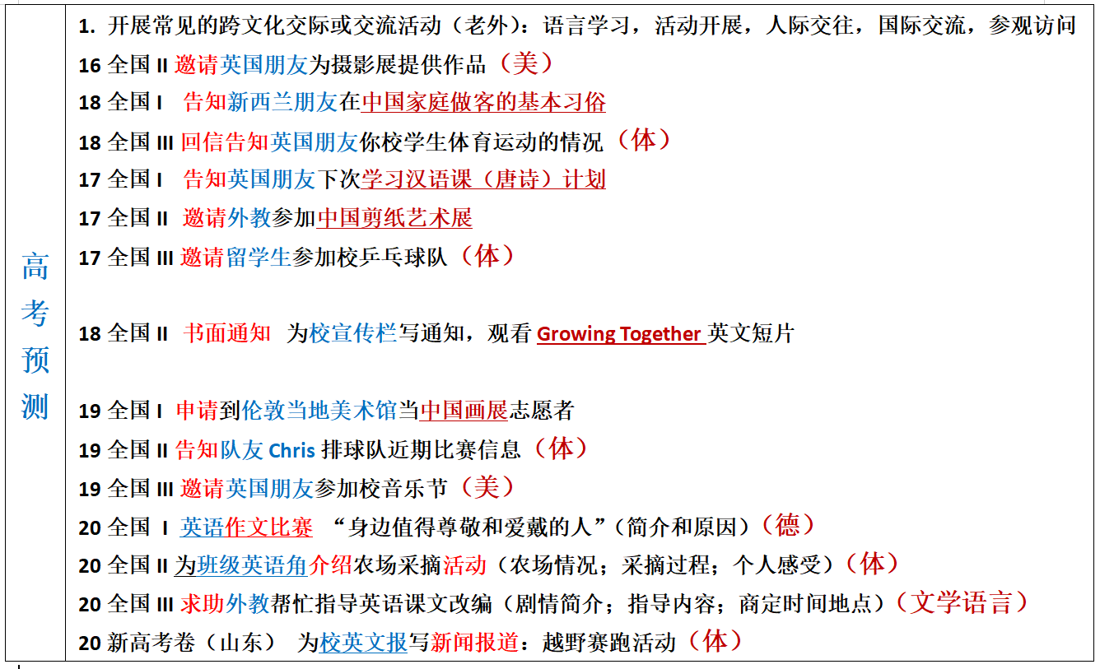
4. 高考方向和预测 —— 体裁（有形式但重意义的传达）
非书信
1.邀请信和告知信备受命题者喜爱
2.五年内未考：
建议信；道歉信；祝贺信；
通知；
发言稿_{（演讲？，欢迎，欢送）}
投诉信？

Slide 42
建议信件；文化输出; 文化学习
（2020学年第二学期五校联考试题 学军中学）假定你是李华，你的新西兰朋友Leo准备来中国学习，他来信向你咨询有关学习汉语的建议。请用英语给他写一封回信。内容包括：1. 表示欢迎；2. 提出建议； 3. 表达期望。
Dear Leo,
Delighted to know that you are coming to study in China, I am writing this to discuss with you on how to learn Chinese.
First, it’s essential to enlarge your vocabulary to overcome your reading difficulties. You should also take any opportunity to communicate in Chinese. Plus, getting to know the culture and history of China will help you learn Chinese better and increase your interest in learning this language.
I hope my suggestions are helpful to you and feel free to drop me a line if you have any other questions.
Yours,
Li Hua

Slide 43
第一节 应用文（满分15分）
假定你是李华，你的新西兰朋友Leo 准备来中国学习，他来信向你咨询有关学习汉语的建议。
请用英语给他写一封回信。内容包括：
1.表示欢迎；
2.提出建议
3.表达期望。
注意：1.词数80左右；
2.可以适当增加细节，以使行文连贯。

Slide 44
Para1(background and writing purpose)
1.Glad to hear your plan to study in China, I’m more than delighted to anticipate your arrival and obliged to offer my personal advice for your Chinese learning as well.
... Cordially anticipating your arrival and steady progress(Ma)
修：1.Glad to hear your plan to study in China, I’ anticipating your arrival and more than delighted to offer/share my personal advice for your Chinese learning as well. ...Cordially anticipating our meeting soon and your steady progress.
2.I’m thrilled to hear your plan to study in China and could hardly wait to meet you. As for the way to learn Chinese wel, my proposals are as follows. (Fan)

Slide 45
Advice:
1.充分接触汉语，如每天收听广播，也是一种有效的方法，因为听力对学习一门语言至关重要。
Full exposure to Chinese, such as listening on the radio daily, is also an effective way as listening is of vital importance to learn a languange.
2.尽可能多地和中国人交流是我的建议之一，这不仅可以练习你的汉语口语，还可以让你在对话中品味地道的汉语。
Communicating as much as possible with the native comes top of my advice, which not only practises your spoken Chinese, but also allows you to savor a dip of authentic Chinese /embrace authentic Chinese during conversations.

Slide 46

FIGHTING

